Slide 1
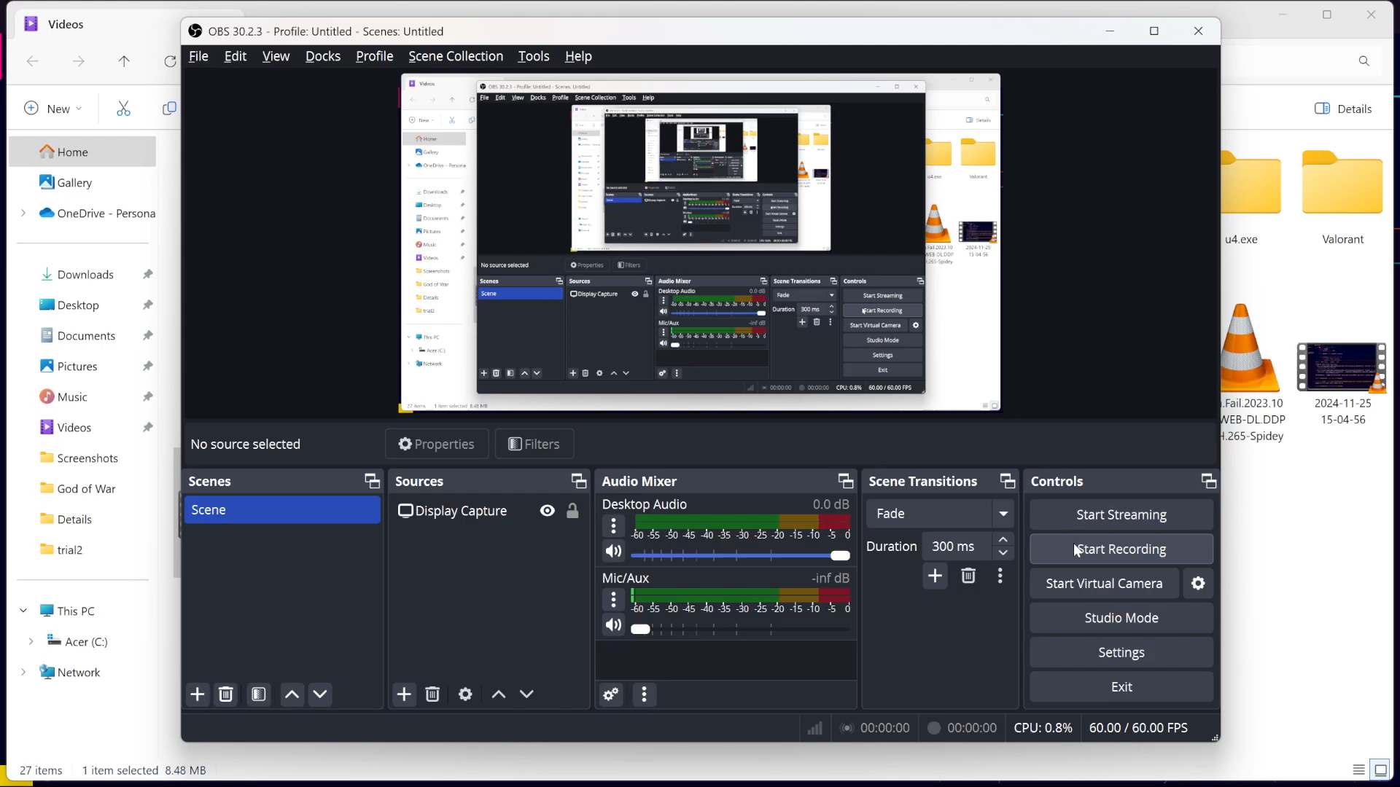


GALACTIC INV DERS
Objective: Control a spaceship, avoid meteors, and shoot them down.
Features: Smooth movement and laser shooting (spacebar).Random meteors with increasing speed. Dynamic score based on survival time.
Visuals & Audio: Space-themed graphics and animated explosions. Sound effects for lasers, collisions, and background music.
Technology: Developed with Python and Pygame. Efficient sprite handling and collision detection. These points are concise and ideal for a single slide in a presentation.
ANTARIKSH MITRA MANDALI
VEDANT VYAS 💪 – 2023UG1013
DHRUV KUMAR 🌟 – 2023UG1002
DEEPENDRA RATHOD 🗡️ – 2023UG1029
VIJIT VISHNOI 🦌 – 2023UG1064

